Slide 1
CSE- 105
Structure Programming
LOOP (REPETITION) STRUCTURES

Slide 2
Problem: Conversion table degrees → radians
Degrees to Radians
0 0.000000
10 0.174533
20 0.349066
30 0.523599
…
340 5.934120
350 6.108653
360 6.283186
radians = degrees * PI / 180;

Slide 3
Sequential Solution
#include <stdio.h>
#define PI 3.141593
int main(void)
{
int degrees=0;
double radians;
printf("Degrees to Radians \n");
degrees = 0;
radians = degrees*PI/180;
printf("%d %f \n", degrees, radians);
degrees = 10;
radians = degrees*PI/180;
printf(“%d %f \n", degrees, radians);
degrees = 20;
radians = degrees*PI/180;
printf(“%d %f \n", degrees, radians);
…
degrees = 360;
radians = degrees*PI/180;
printf(“%d %f \n", degrees, radians);
}
degrees = ???
radians = degrees*PI/180;
printf("%d %f \n", degrees, radians);
Not a good solution

Slide 4
Loop Solution
#include <stdio.h>
#define PI 3.141593
int main(void)
{
int degrees=0;
double radians;
printf("Degrees to Radians \n");
while (degrees <= 360) {
radians = degrees*PI/180;
printf(“%d %f \n", degrees, radians);
degrees += 10;
}
}
degrees = ???
radians = degrees*PI/180;
printf("%d %f \n", degrees, radians);

Slide 5
Loop Solution
#include <stdio.h>
#define PI 3.141593
int main(void)
{
int degrees=0;
double radians;
printf("Degrees to Radians \n");
while (degrees <= 360)
{
radians = degrees*PI/180;
printf(“%d %f \n", degrees, radians);
degrees += 10;
}
}
degrees = ???
radians = degrees*PI/180;
printf("%d %f \n", degrees, radians);

Slide 6
Loop Solution
#include <stdio.h>
#define PI 3.141593
int main(void)
{
int degrees=0;
double radians;
printf("Degrees to Radians \n");
while (degrees <= 360)
{
radians = degrees*PI/180;
printf(“%d %f \n", degrees, radians);
degrees += 10;
}
}
degrees = ???
radians = degrees*PI/180;
printf("%d %f \n", degrees, radians);

Slide 7
Loop (Repetition) Structures
while statement
do while statement
for statement
Two new statements used with loops
  break and continue

Slide 8
while statement
while(expression)
statement;
while(expression) {
statement;
statement;
.
}
Task is similar as was in if-else

Slide 9
The while Control Structure
Example:
x = 1; i = 1;
while (i <= 9) {
x = x * i;
i = i + 1;
}
Initially
x = 1; i = 1;
true
i <= 9
x = x * i; i = i + 1;
false

Slide 10
The while Control Structure
Example:
x = 1; i = 1;
while (i <= 9) {
x = x * i;
i = i + 1;
}
Initially, x = 1, i= 1
Iteration 1 :
  i <= 9 is true
    x = x * i = 1*1 = 1
    i = i+1 = 1+1 = 2

Slide 11
The while Control Structure
Example:
x = 1; i = 1;
while (i <= 9) {
x = x * i;
i = i + 1;
}
Now, x = 1, i= 2
Iteration 2 :
  i <= 9 is true
    x = x * i = 1*2 = 2
    i = i+1 = 2+1 = 3

Slide 12
The while Control Structure
Example:
x = 1; i = 1;
while (i <= 9) {
x = x * i;
i = i + 1;
}
Now, x = 2, i= 3
Iteration 3 :
  i <= 9 is true
    x = x * i = 2*3 = 6
    i = i+1 = 3+1 = 4

Slide 13
The while Control Structure
Example:
x = 1; i = 1;
while (i <= 9) {
x = x * i;
i = i + 1;
}
Now, x = 6, i= 4
Iteration 4 :
  i <= 9 is true
    x = x * i = 6*4 = 24
    i = i+1 = 4+1 = 5

Slide 14
The while Control Structure
Example:
x = 1; i = 1;
while (i <= 9) {
x = x * i;
i = i + 1;
}
Now, x = 24, i= 5
Iteration 5 :
  i <= 9 is true
    x = x * i = 24*5 = 120
    i = i+1 = 5+1 = 6

Slide 15
The while Control Structure
Example:
x = 1; i = 1;
while (i <= 9) {
x = x * i;
i = i + 1;
}
Now, x = 120, i= 6
Iteration 6 :
  i <= 9 is true
    x = x * i = 120*6 = 720
    i = i+1 = 6+1 = 7

Slide 16
The while Control Structure
Example:
x = 1; i = 1;
while (i <= 9) {
x = x * i;
i = i + 1;
}
Now, x = 720, i= 7
Iteration 7 :
  i <= 9 is true
    x = x * i = 720*7 = 5760
    i = i+1 = 7+1 = 8

Slide 17
The while Control Structure
Example:
x = 1; i = 1;
while (i <= 9) {
x = x * i;
i = i + 1;
}
Now, x = 5760, i= 8
Iteration 8 :
  i <= 9 is true
    x = x * i = 5760*8 = 46080
    i = i+1 = 8+1 = 9

Slide 18
The while Control Structure
Example:
x = 1; i = 1;
while (i <= 9) {
x = x * i;
i = i + 1;
}
Now, x = 46080, i= 9
Iteration 9 :
  i <= 9 is true
    x = x * i = 46080*9 = 414720
    i = i+1 = 9+1 = 10

Slide 19
The while Control Structure
Example:
x = 1; i = 1;
while (i <= 9) {
x = x * i;
i = i + 1;
}
Now, x = 414720, i= 10
Iteration 10 :
  i <= 9 is false
    Out of loop

Slide 20
Example
Output
Degrees to Radians
0 0.000000
0.174533
20 0.349066
… … …
… … …
… … …
… … …
6.108653
360 6.283186
Press any key to continue
#include <stdio.h>
#define PI 3.141593
int main(void)
{
int degrees=0;
double radians;
printf("Degrees to Radians \n");
while (degrees <= 360)
{
radians = degrees*PI/180;
printf("%d %.6f \n", degrees, radians);
degrees += 10;
}
return 0;
}

Slide 21
Example
Output
Degrees to Radians
0 0.000000
0.174533
20 0.349066
… … …
… … …
… … …
… … …
6.108653
360 6.283186
Press any key to continue
Output
Degrees to Radians
0 0.000000
100 1.745329
200 3.490659
300 5.235988
Press any key to continue
#include <stdio.h>
#define PI 3.141593
int main(void)
{
int degrees=0;
double radians;
printf("Degrees to Radians \n");
while (degrees <= 360)
{
radians = degrees*PI/180;
printf("%d %.6f \n", degrees, radians);
degrees += 100;
}
return 0;
}

Slide 22
Example
Output
Degrees to Radians
0 0.000000
0.174533
20 0.349066
… … …
… … …
… … …
… … …
6.108653
360 6.283186
Press any key to continue
Output
Degrees to Radians
0 0.000000
1.745329
Press any key to continue
#include <stdio.h>
#define PI 3.141593
int main(void)
{
int degrees=0;
double radians;
printf("Degrees to Radians \n");
while (degrees <= 160)
{
radians = degrees*PI/180;
printf("%d %.6f \n", degrees, radians);
degrees += 100;
}
return 0;
}

Slide 23
Example
Globally define
Output
Degrees to Radians
0 0.000000
0.174533
… …
… … …
… … …
… … …
6.108653
360 6.283186
Press any key to continue
#include <stdio.h>
#define PI 3.141593
int main(void)
{
int degrees=0;
double radians;
printf("Degrees to Radians \n");
while (degrees <= 60)
{
radians = degrees*PI/180;
printf("%d %.6f \n", degrees, radians);
degrees += 10;
}
return 0;
}

Slide 24
Example
Output
Degrees to Radians
0 0.000000
0.174533
20 0 …
… … …
… … …
… … …
6.108653
360 6.283186
Press any key to continue
#include <stdio.h>
int main(void)
{
#define PI 3.141593
int degrees=0;
double radians;
printf("Degrees to Radians \n");
while (degrees <= 60)
{
radians = degrees*PI/180;
printf("%d %.6f \n", degrees, radians);
degrees += 10;
}
return 0;
}
Locally define

Slide 25
Example
Output
Degrees to Radians
0 0.000000
0.174533
20 …
… … …
… … …
… … …
6.108653
360 6.283186
Press any key to continue
#include <stdio.h>
int main(void)
{
int degrees=0;
double radians;
printf("Degrees to Radians \n");
while (degrees <= 60)
{
radians = degrees*3.1416/180;
printf("%d %.6f \n", degrees, radians);
degrees += 10;
}
return 0;
}
Value is used right through

Slide 26
Example
Output
Press any key to continue
0.174533
20 0.349066
… … …
… … …
continue
#include <stdio.h>
int main(void)
{
int degrees=100;
double radians;
printf("Degrees to Radians \n");
while (degrees <= 60)
{
radians = degrees*3.1416/180;
printf("%d %.6f \n", degrees, radians);
degrees += 10;
}
return 0;
}
No Execution

Slide 27
do while
do
statement;
while(expression);
do
{
statement1;
statement2;
.
}
while(expression);
Note - the expression is tested after the statement(s) are executed, so statements are executed at least once.

Slide 28
Example
Output
Degrees to Radians
100 1.745333
Press any key to continue 20 0.349066
… … …
… … …
continue
#include <stdio.h>
int main(void)
{
int degrees=100;
double radians;
printf("Degrees to Radians \n");
do
{
radians = degrees*3.1416/180;
printf("%d %.6f \n", degrees, radians);
degrees += 10;
}
while (degrees <= 60);
return 0;
}
1 Execution
At least

Slide 29
4.8 The do…while Repetition Statement
Flowchart of the do…while repetition statement
action(s)
true
condition
false

Slide 30
for statement
for(initialization; test; increment or decrement)
statement;
for(initialization; test; increment or decrement)
{
statement;
statement;
.
}

Slide 31
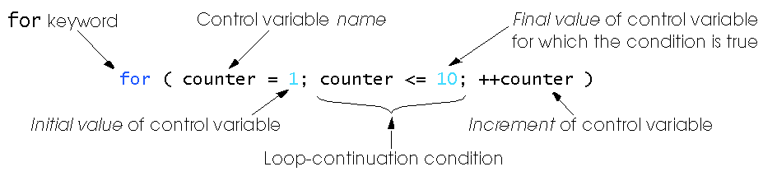
4.4 The for Repetition Statement

Slide 32
Example
Output
Degrees to Radians
0 0.000000
0.174533
20 0.349066
… … …
… … …
… … …
… … …
6.108653
360 6.283186
Press any key to continue
#include <stdio.h>
#define PI 3.141593
int main(void)
{
int degrees;
double radians;
printf("Degrees to Radians \n");
for (degrees=0; degrees<=360; degrees+=10)
{
radians = degrees*PI/180;
printf("%6i %9.6f \n", degrees, radians);
}
return 0;
}

Slide 33
Example
Output
Degrees to Radians
0 0.000000
0.174533
20 0.349066
… … …
… … …
… … …
… … …
6.108656
Press any key to continue
Output
Degrees to Radians
0 0.000000
100 1.745329
200 3.490659
300 5.235988
Press any key to continue
#include <stdio.h>
#define PI 3.141593
int main(void)
{
int degrees;
double radians;
printf("Degrees to Radians \n");
for (degrees=0; degrees<=360; degrees+=100)
{
radians = degrees*PI/180;
printf("%6i %9.6f \n", degrees, radians);
}
return 0;
}

Slide 34
Example
Output
Degrees to Radians
0 0.000000
0.174533
20 0.349066
… … …
… … …
… … …
… … …
6.108656
Press any key to continue
Output
Degrees to Radians
0 0.000000
1.745329
Press any key to continue
#include <stdio.h>
#define PI 3.141593
int main(void)
{
int degrees;
double radians;
printf("Degrees to Radians \n");
for (degrees=0; degrees<=160; degrees+=100)
{
radians = degrees*PI/180;
printf("%6i %9.6f \n", degrees, radians);
}
return 0;
}

Slide 35
4.4 The for Repetition Statement
Format when using for loops
    for ( initialization; loopContinuationTest; increment )
    statement
Example:
    for(counter = 1; counter <= 10; counter++ )
    printf( "%d\n", counter );
  Prints the integers from one to ten
No semicolon (;) after last expression

Slide 36
4.4 The for Repetition Statement
Format when using for loops
    for ( initialization; loopContinuationTest; increment )
    statement
Example:
    for(counter = 1; counter <= 10; counter++ );
    printf( "%d\n", counter );
  Prints the integers Eleven only
If
semicolon (;) after last expression only the final value will be printed after increment

Slide 37
Flow Chart of the Example for Loop
Establish
initial
value
of control
variable
counter = 1
counter = 1
counter <= 10
true
printf( "%d", counter );
counter++
Increment
Determine if
final
the control
false
Body of loop
variable
value
of control
(this may be many
variable has been
statements)
reached

Slide 38
The for Repetition Statement
For loops can usually be rewritten as while loops:
    initialization;
    while ( loopContinuationTest ) {
    statement;
    increment;
    }
Initialization and increment
  Can be more than one, comma-separated lists of statements
  Can even add the counter variable declaration in initialization
  Example:
    for (int i = 0, j = 0; j + i <= 10; j++, i++)
    printf( "%d\n", j + i );
Notes:
0
2
4
6
8
10
Press any key to continue

Slide 39
Examples
int sum =0;
for( int i=1 ; i < 7 ; i+=2 )
sum = sum + i;
?
0
3
1
5
7
i
sum
1
4
9
False so done
i = 7, sum = 9

Slide 40
Examples
int fact =1;
for(int n=5;n>1;n--)
fact = fact * n;
5
1
n
fact
Find the final Value of n and fact

Slide 41
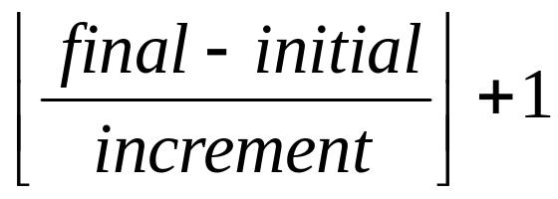
Exercise
Determine the number of times that each of the following for loops are executed.
for (k=3; k<=10; k++) {
statements;
}
for (k=3; k<=10; ++k) {
statements;
}
for(count=-2;count<=5; count++) {
statements;
}
Notes:
1 st one 8 times
2nd one 8 times
3rd one 8 times

Slide 42
Example
What will be the output of the following program, also show how values of variables change in the memory.
int sum1, sum2, k;
sum1 = 0;
sum2 = 0;
for( k = 1; k < 5; k++) {
if( k % 2 == 0)
sum1 =sum1 + k;
else
sum2 = sum2 + k;
}
printf(“sum1 is %d\n”, sum1);
printf(“sum2 is %d\n”, sum2);
0 2 6
0 1 4
1 2 3 4 5
sum1
sum2
k

Slide 43
Example
What will be the output of the following program, also show how values of variables change in the memory.
int sum1, sum2, k;
sum1 = 0;
sum2 = 0;
for( k = 1; k < 5; k++) {
if( k % 2 == 0)
sum1 =sum1 + k;
else
sum2 = sum2 + k;
}
printf(“sum1 is %d\n”, sum1);
printf(“sum2 is %d\n”, sum2);
0 2 6
0 1 4
1 2 3 4 5
sum1
sum2
k

Slide 44
Example
What will be the output of the following program, also show how values of variables change in the memory.
int sum1, sum2, k;
sum1 = 0;
sum2 = 0;
for( k = 1; k < 5; k++) {
if( k % 2 == 0)
sum1 =sum1 + k;
else
sum2 = sum2 + k;
}
printf(“sum1 is %d\n”, sum1);
printf(“sum2 is %d\n”, sum2);
0 2 6
0 1 4
1 2 3 4 5
sum1
sum2
k

Slide 45
Example
What will be the output of the following program, also show how values of variables change in the memory.
int sum1, sum2, k;
sum1 = 0;
sum2 = 0;
for( k = 1; k < 5; k++) {
if( k % 2 == 0)
sum1 =sum1 + k;
else
sum2 = sum2 + k;
}
printf(“sum1 is %d\n”, sum1);
printf(“sum2 is %d\n”, sum2);
0 2 6
0 1 4
1 2 3 4 5
sum1
sum2
k

Slide 46
Example
What will be the output of the following program, also show how values of variables change in the memory.
int sum1, sum2, k;
sum1 = 0;
sum2 = 0;
for( k = 1; k < 5; k++) {
if( k % 2 == 0)
sum1 =sum1 + k;
else
sum2 = sum2 + k;
}
printf(“sum1 is %d\n”, sum1);
printf(“sum2 is %d\n”, sum2);
0 2 6
0 1 4
1 2 3 4 5
sum1
sum2
k

Slide 47
Example
What will be the output of the following program, also show how values of variables change in the memory.
int sum1, sum2, k;
sum1 = 0;
sum2 = 0;
for( k = 1; k < 5; k++) {
if( k % 2 == 0)
sum1 =sum1 + k;
else
sum2 = sum2 + k;
}
printf(“sum1 is %d\n”, sum1);
printf(“sum2 is %d\n”, sum2);
0 2 6
0 1 4
1 2 3 4 5
sum1
sum2
k

Slide 48
Example
What will be the output of the following program, also show how values of variables change in the memory.
int sum1, sum2, k;
sum1 = 0;
sum2 = 0;
for( k = 1; k < 5; k++) {
if( k % 2 == 0)
sum1 =sum1 + k;
else
sum2 = sum2 + k;
}
printf(“sum1 is %d\n”, sum1);
printf(“sum2 is %d\n”, sum2);
0 2 6
0 1 4
1 2 3 4 5
sum1
sum2
k

Slide 49
Example
What will be the output of the following program, also show how values of variables change in the memory.
int sum1, sum2, k;
sum1 = 0;
sum2 = 0;
for( k = 1; k < 5; k++) {
if( k % 2 == 0)
sum1 =sum1 + k;
else
sum2 = sum2 + k;
}
printf(“sum1 is %d\n”, sum1);
printf(“sum2 is %d\n”, sum2);
0 2 6
0 1 4
1 2 3 4 5
sum1
sum2
k

Slide 50
Example
What will be the output of the following program, also show how values of variables change in the memory.
int sum1, sum2, k;
sum1 = 0;
sum2 = 0;
for( k = 1; k < 5; k++) {
if( k % 2 == 0)
sum1 =sum1 + k;
else
sum2 = sum2 + k;
}
printf(“sum1 is %d\n”, sum1);
printf(“sum2 is %d\n”, sum2);
0 2 6
0 1 4
1 2 3 4 5
sum1
sum2
k
Expression is false
sum1 is 6
sum2 is 4

Slide 51
Exercise
What is the output of the following program?
  for (i=1; i<=5; i++) {
  for (j=1; j<=4; j++){
  printf(“*”);
  }
  printf(“\n”);
  }
Output
****
****
****
****
****

Slide 52
Exercise
What is the output of the following program?
  for (i=1; i<=5; i++) {
  for (j=1; j<=i; j++){
  printf(“*”);
  }
  printf(“\n”);
  }
Output
*
**
***
****
*****

Slide 53
Example: nested loops to generate the following output
  i=1 *
  i=2 + +
  i=3 * * *
  i=4 + + + +
  i=5 * * * * *
int i, j;
for(i=1; i <= 5; i++){
printf("i=%d ", i);
for(j=1; j <= i; j++) {
if (i % 2 == 0)
printf("+ ");
else
printf("* ");
}
printf("\n");
}

Slide 54
Exercise: Modify the following program to produce the output.
  for (i=A; i<=B; i++) {
  for (j=C; j<=D; j++) {
  printf(“*”);
  }
  printf(“\n”);
  }
Output
*****
****
***
**
*

Slide 55
Exercise
Write a program using loop statements to produce the output.
Output
*
**
***
****
*****

Slide 56
For vs. while loop
Convert the following for loop to while loop
for( i=5; i<10; i++) {
pritntf(“ i = %d \n”, i);
}
i=5;
while(i<10){
pritntf(“ i = %d \n”, i);
i++;
}

Slide 57
For vs. while loop : Convert the following for loop to while loop
for( i=5; i<10; i++) {
printf(“AAA %d \n”, i);
if (i % 2==0) continue;
pritntf(“BBB %d \n”, i);
}
i=5;
while(i<10) {
printf(“AAA %d \n”, i);
if (i % 2==0) {
i++;
continue;
}
pritntf(“BBB %d \n”, i);
i++;
}

Slide 58
Compute x^{y} when y is integer
Suppose we don’t have pow(x,y) and y is integer, write a loop to compute x^{y}
Enter x, y
res=1;
for(i=1; i<=y; i++){
res = res * x;
}

Slide 59
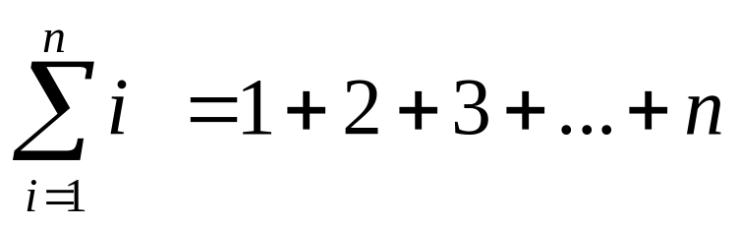

Exercise: sum
Write a program to compute the following
Enter n
total=0;
for(i=1; i<=n; i++)
total = total + i ;
print total
Enter n
total=0;
for(i=1; i<=n; i++)
total = total + 2 * i ;
print total

Slide 60
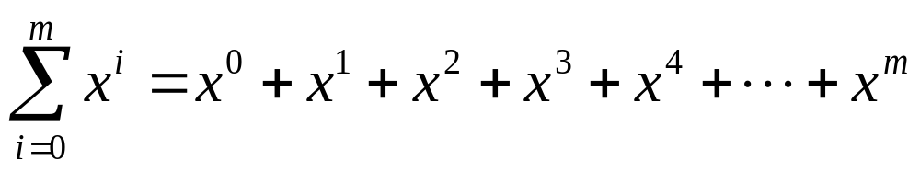
Exercise: sum
Write a program to compute the following
Enter x and m
total=0; sofarx=1;
for(i=0; i<=m; i++) {
total = total +sofarx;
sofarx = sofarx * x;
}
print total
Enter x and m
total=0;
for(i=0; i<=m; i++)
total = total + pow(x, i);
print total

Slide 61
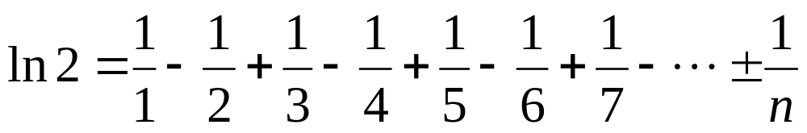
Exercise: ln 2
Write a program to compute the following
Enter n
ln2=0;
for(i=1; i<=n; i++)
if ( i % 2 == 0)
ln2 = ln2 - 1.0 / i;
else
ln2 = ln2 + 1.0 / i;
print total

Slide 62
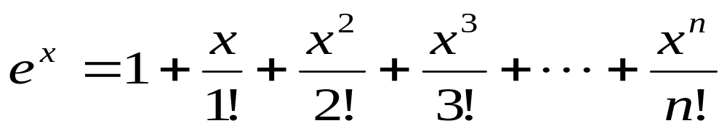
Exercise: e^{x}
Write C program that reads the value of x and n from the keyboard and then approximately computes the value of using the following formula:
Then compare your approximate result to the one returned by exp(x) in C library, and print out whether your approximation is higher or lower.

Slide 63
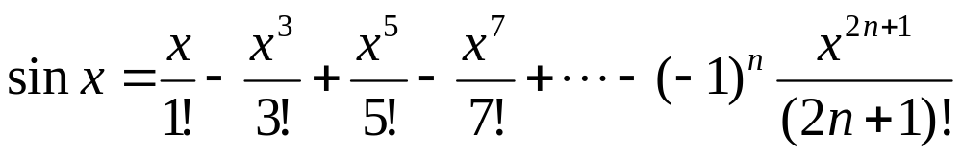
Exercise: sin x
Compute sin x using
Get n
total=0; powx=x; factx=1;
for(i=0; i <= n; i++){
k= 2*n+1;
if (i%2==0) total= total - powx/factx;
else total= total + powx/factx;
powx= powx * x * x;
factx = factx * k * (k-1);
}
Print total;

Slide 64
Example
Write a program that prints in two columns n even numbers starting from 2, and a running sum of those values. For example suppose user enters 5 for n, then the program should generate the following table:
Enter n (the number of even numbers): 5
Value Sum
2 2
4 6
6 12
8 20
10 30

